Slide 1
Minimum Spanning Tree (MST)
Mohammad Shahid Qureshi

Slide 2
Definitions
Minimum Spanning Tree
  A tree made out of the graph with minimum total weight of all the links.

Slide 3
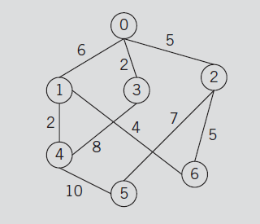
Airline routes between seven cities
Airline wants to save costs by cancelling some of the routes, but don’t want to miss any city

Slide 4
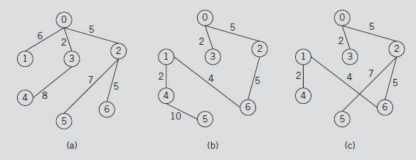
Some possibilities

Slide 5
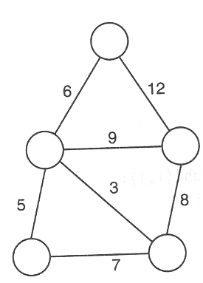
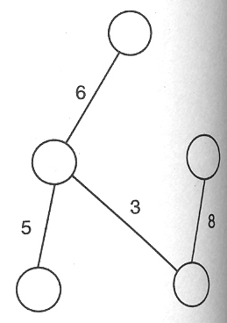
Another example

Slide 6

For Example, Problem laying Telephone Wire.

Slide 7

Wiring

Slide 8


Slide 9
Minimum Spanning Tree Algorithms
Many solutions exists for the construction of MST, e.g.,
  Expanding a set of trees to form one spanning tree (Kruskal’s method)
  Creating and expanding only one tree by adding new branches to it (Prim’s algorithm)

Slide 10
Kruskal’s Algorithm
Initially we have n vertex sets, each with one member
As we add edges, the sets will become fewer and larger until one set contains all n vertices

Slide 11
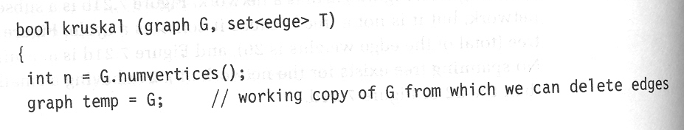
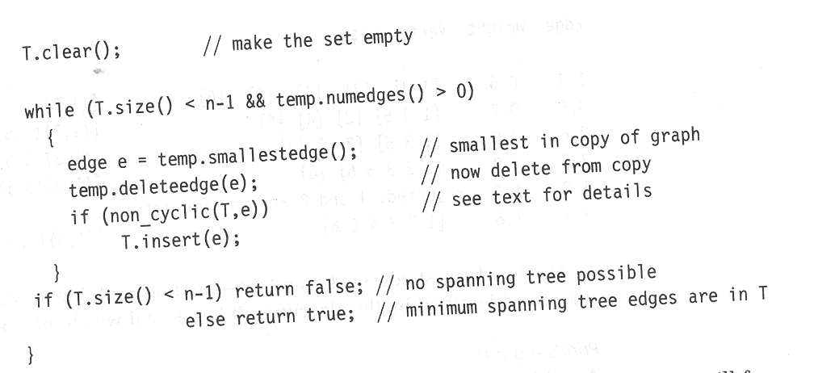

Slide 12
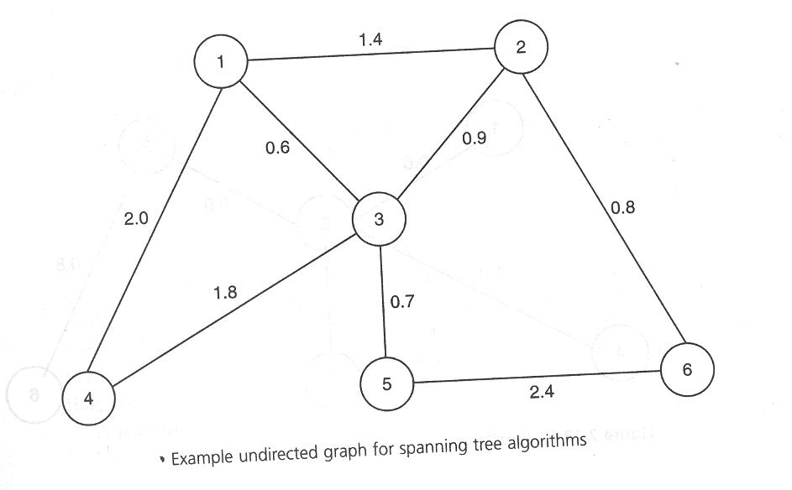

Slide 13
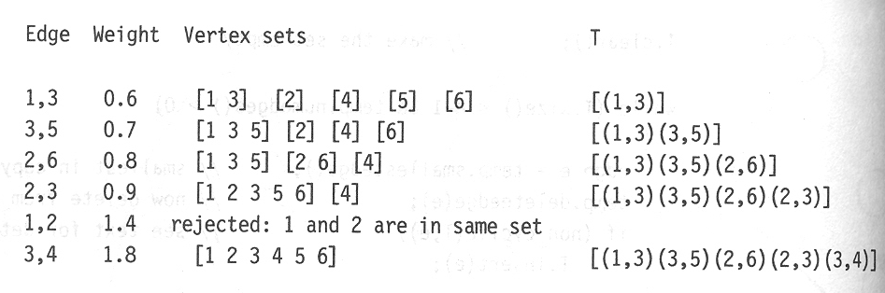
Trace of Kruskal’s Algorithm

Slide 14
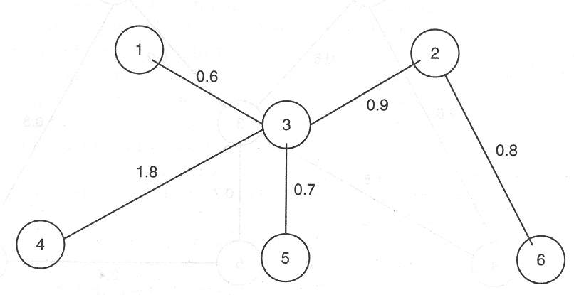
Spanning Tree

Slide 15
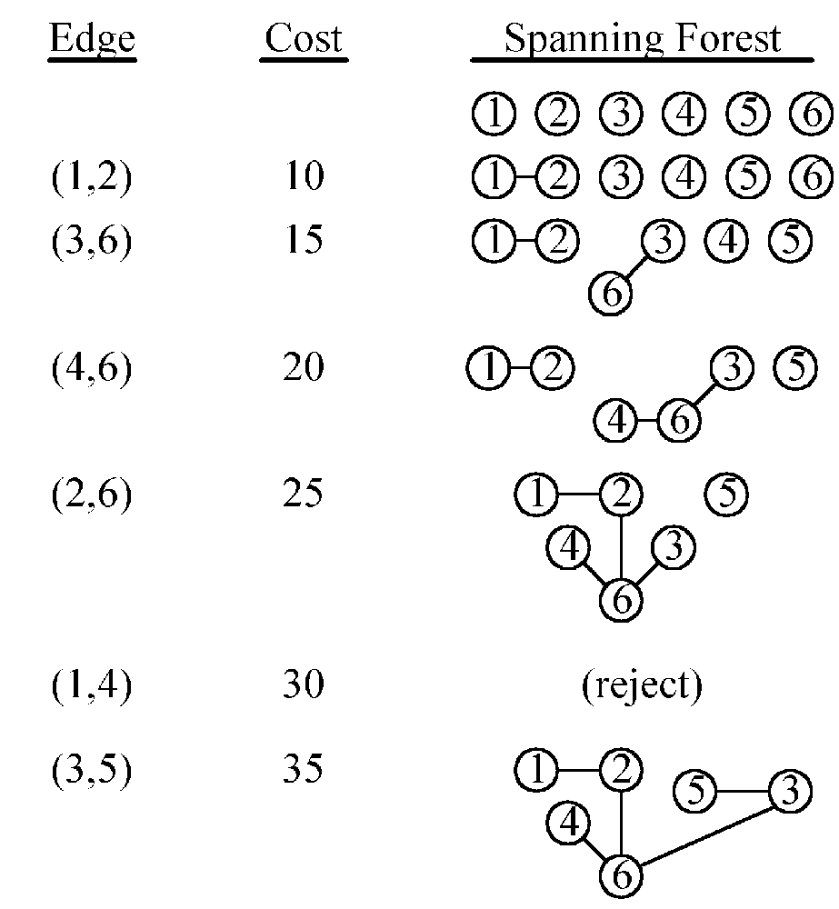
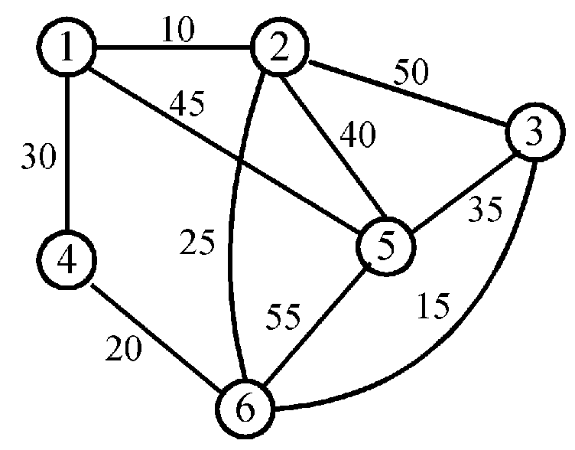
Kruskal’s Algorithm

Slide 16
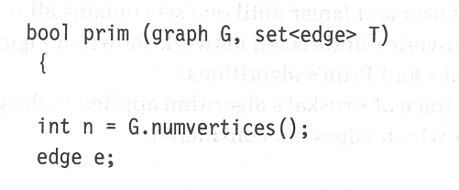
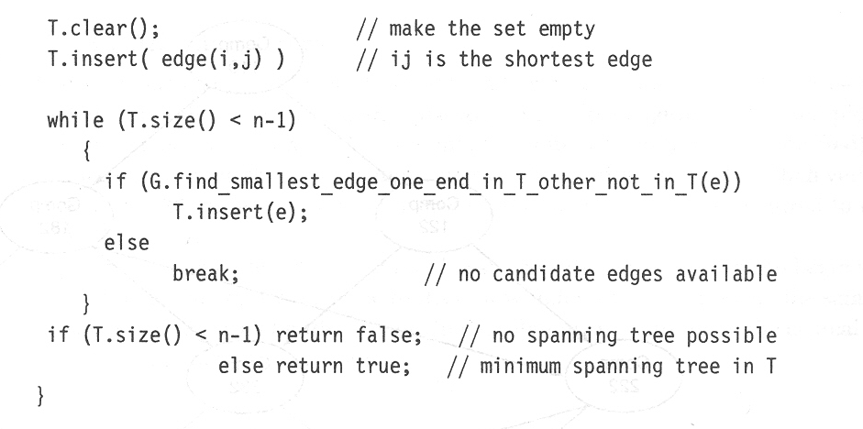
Prim’s Algorithm
Creating and expanding only one tree by adding new branches to it

Slide 17
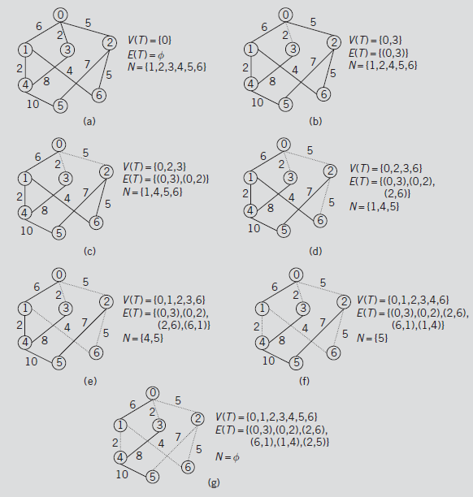

Slide 18
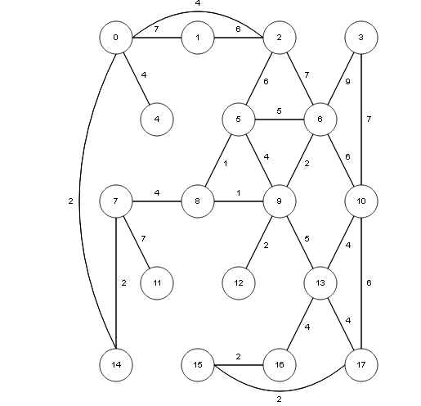

Slide 19
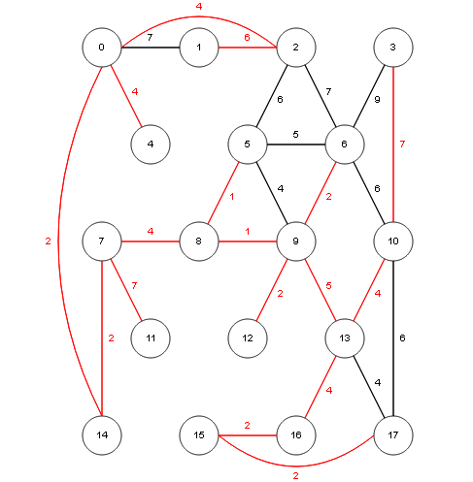
Red edges are selected for the Minimum Spanning Tree

Slide 20
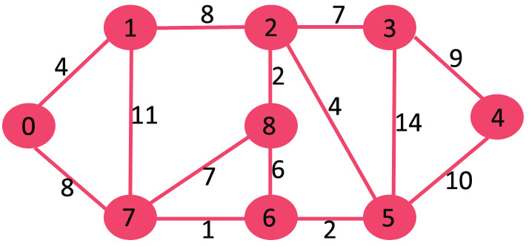

Slide 21

Prim’s MST

Slide 22
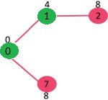

Slide 23
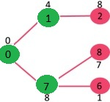

Slide 24
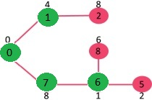

Slide 25
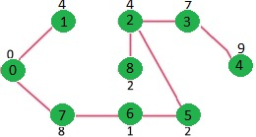

Slide 26

Implementation

Slide 27
void primMST(int graph[V][V])
{
int parent[V];
int key[V];
bool mstSet[V];
for (int i = 0; i < V; i++)
key[i] = INT_MAX, mstSet[i] = false;
key[0] = 0;
parent[0] = -1; // First node is always root of MST
for (int count = 0; count < V-1; count++)
{
int u = minKey(key, mstSet);
mstSet[u] = true;
for (int v = 0; v < V; v++)
if (graph[u][v] && mstSet[v] == false && graph[u][v] < key[v])
parent[v] = u, key[v] = graph[u][v];
}
printMST(parent, V, graph);
}

Slide 28
int minKey(int key[], bool mstSet[])
{
int min = INT_MAX, min_index;
for (int v = 0; v < V; v++)
if (mstSet[v] == false && key[v] < min)
min = key[v], min_index = v;
return min_index;
}
int printMST(int parent[], int n, int graph[V][V])
{
Cout<<"Edge \tWeight\n";
for (int i = 1; i < V; i++)
cout<<parent[i]<<“- “<<i<< “\t” <<graph[i][parent[i]]<<\n“;
);
}

